Slide 1
2024 Bayesian Modelling Workshop
Seungjae Lee
Department of Civil & Mineral Engineering
University of Toronto
July 30, 2024

Slide 2
Workshop Outline
Measurement uncertainty and Bayesian estimation
Bayesian linear regression
Latent/unobservable variables
Advanced Topics (if time allows):
Gaussian process regression
Bayesian optimization
Probabilistic deep learning

Slide 3
Gaussian Process
In probability theory and statistics, a Gaussian process is a stochastic process (a collection of random variables indexed by time or space), such that every finite collection of those random variables has a multivariate normal distribution

Slide 4
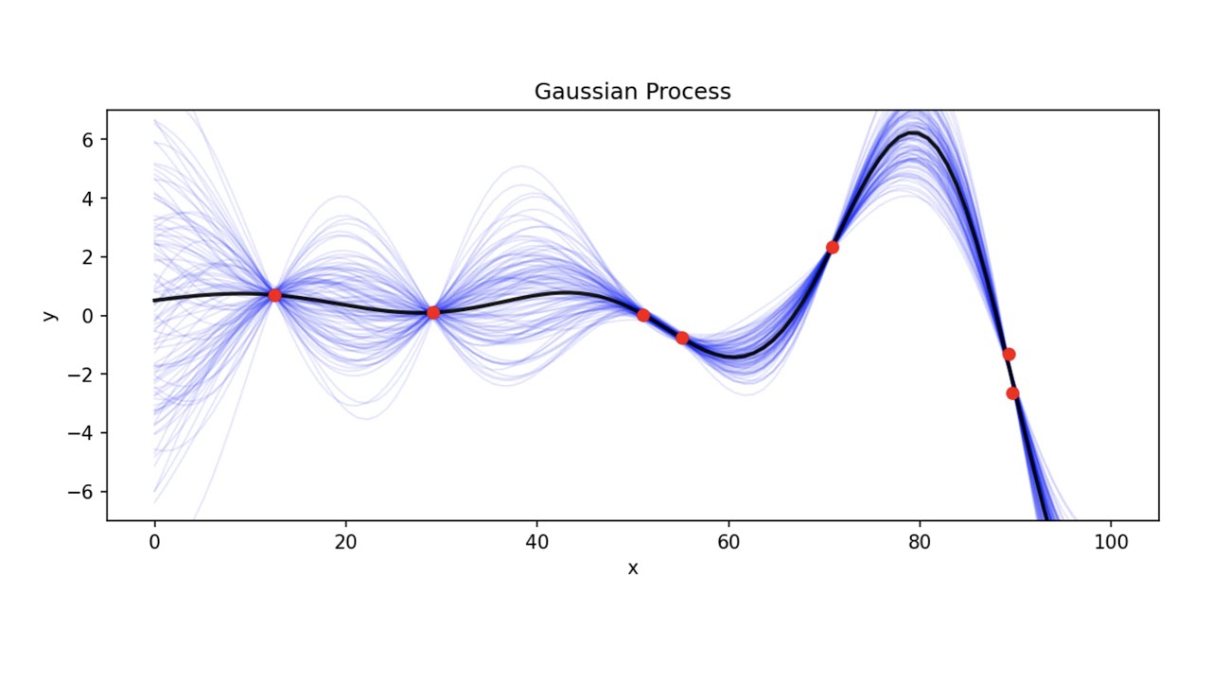
Gaussian Process

Slide 5
Bayesian Design of Experiment / Optimization

Slide 6
Bayesian Design of Experiment / Optimization

Slide 7
Exercise

Slide 8
Thank you
Seungjae Lee
sjae.lee@utoronto.ca

